Slide 1


Carbon Emissions Estimation In
Edge Cloud Computing
Simulations
Dissertation Presentation
James Andrew Nurdin, 2570809n
March 2024
Notes:
Hello, I am James Andrew Nurdin, student ID 2570809n. Today, I will be presenting my level 4 honours dissertation on Carbon Emissions Estimation In Edge Cloud Computing Simulations.

Slide 2
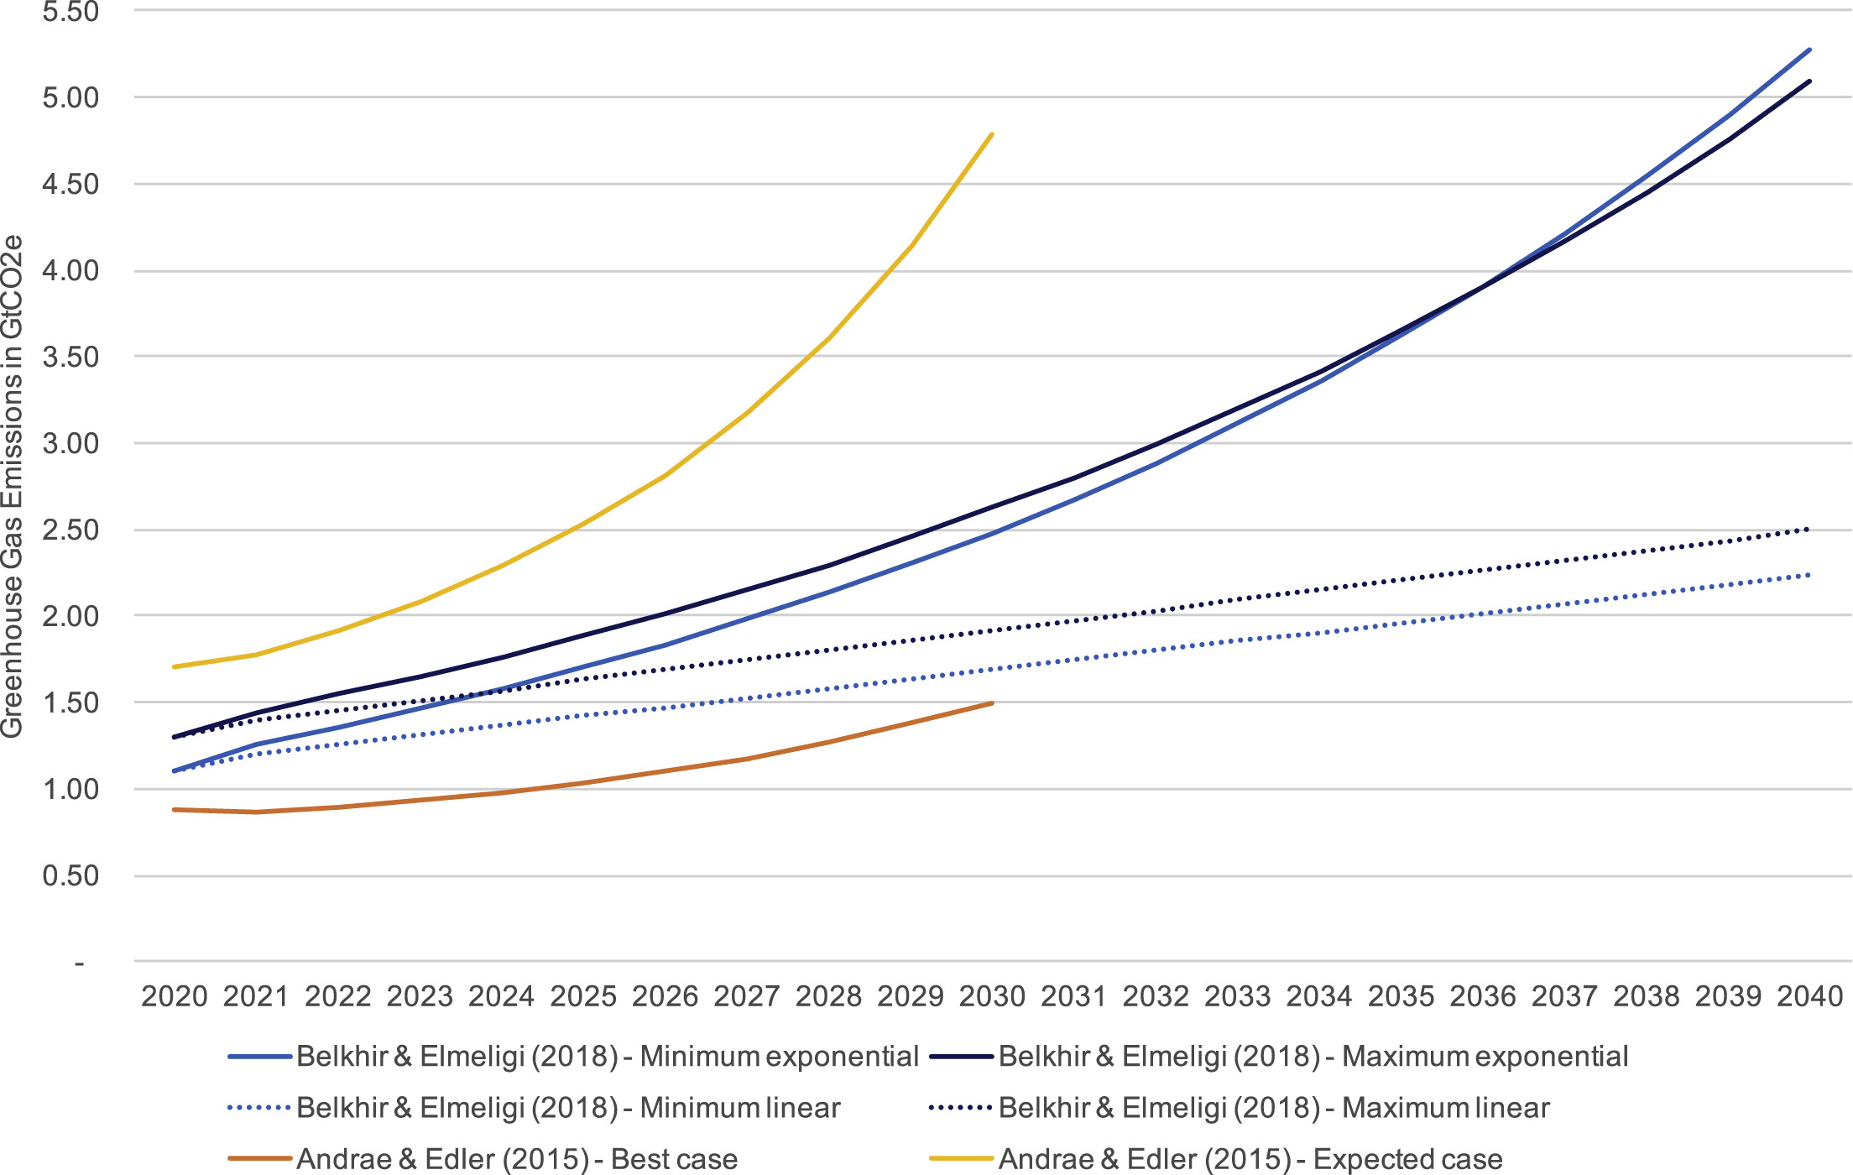
The Environmental Impact of Computing
Currently 2.1 – 3.9% of global carbon emissions are produced by the ICT industry (Freitag et al. 2021).
This value is only expected to rise.
A result of the increasing use of cloud computing and the demand from the Internet of Things (IoT).
In 2021, there were 172 million cellular IoT connections in Europe, in 2025, this is forecasted to double to 406 million (Savills Research, 2022).
Projections of ICT's GHG emissions from 2020
Source: The real climate and transformative impact of ICT: A critique of estimates, trends, and regulations, Freitag et al.
March 2024
Carbon Emission Estimation In Edge Cloud Computing Simulations
2
Notes:
Over the past decade, the information and communication technology industry has drastically increased its share of global energy consumption and, consequently, its emission of greenhouse gasses. A recent study approximates that the ICT industry emits around 2.1-3.9 % of global greenhouse gas emissions.
This value is only expected to rise, while there have been many debates about the rate of increase, with many older forecasts predicting a much faster rate. As we can see in the figure on the right its clear that most projections expect that the industry's percentage share of global emissions will increase.
This can be partially attributed to the industry's increasing use of cloud computing services and the adoption of the Internet of Things. As cloud computing has existed for many decades, the recent increase in IoT devices has caused demands to improve latencies, reduce bandwidth consumption and increase security for many networks.
This is a major problem for cloud computing. In 2021, there were 172 million cellular I0T connections in Europe; in 2025, this is forecasted to double and reach 406 million. As a result, a new networking principle must be considered to resolve both the increasing use of energy in data centres and issues plaguing IoT devices.

Slide 3
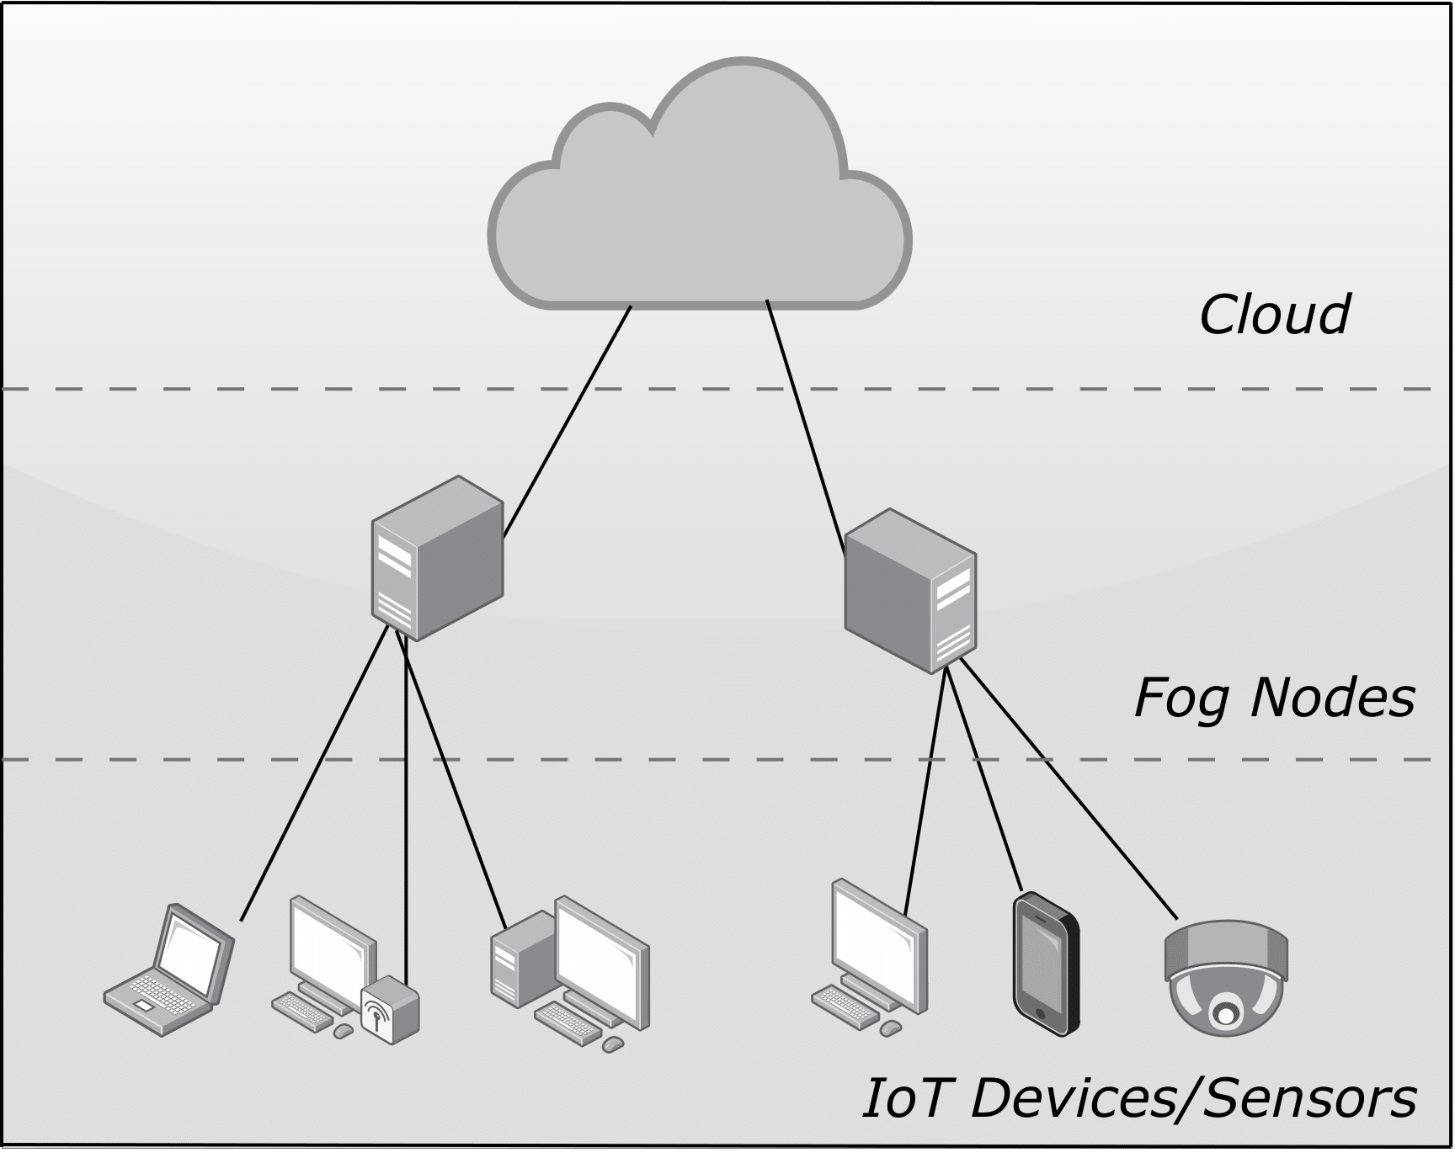
How is this being addressed?
Fog computing is a new paradigm that the networking company Cisco proposed in 2012.
The platform seeks to address the shortcomings of the traditional cloud computing platform by:
Reducing latency
Saving Bandwidth
Increasing security
It achieves this by placing computational fog nodes located across the edge of the network to distribute workload away from data centres.
March 2024
Carbon Emission Estimation In Edge Cloud Computing Simulations
3
Notes:
One such solution, fog computing, is a new platform proposed by the networking company Cisco back in 2012. As you can see in the diagram, it comprises three core aspects: the cloud, fog nodes, and IoT devices.
Fog computing expands upon the cloud computing paradigm and seeks to address its issues by claiming to reduce latency and bandwidth in transmissions and, finally, increase security for devices on the network.
It achieves all of this by placing fog nodes at the edge of the network. By doing so, computational workload can be distributed away from data centres, offering services much closer to the network's end devices.

Slide 4
Fog Computing Simulators
Research has shown that in certain situations fog computing has reduced electricity consumption by 80% (Yan et al. 2019).
Most of the research is carried out through simulation models.
Despite many simulators existing, in recent years, a variety of fog computing simulators have been introduced to provide power modelling
iFogSim/iFogSim2
PureEdgeSim
LEAF
MintEDGE
When considering the broader perspective, a possible question can come to mind?... How is this power being provided?
March 2024
Carbon Emission Estimation In Edge Cloud Computing Simulations
4
Notes:
The benefits of fog computing are already being seen. For instance, research has shown that in certain situations, fog computing can reduce electricity consumption by 80%. By decentralising computational tasks at the centre of the network, alternative and renewable power sources have the potential to be used amongst fog nodes to reduce carbon emissions.
Due to the complexity of producing these topologies and the relevant infancy of the platform, most research is carried out through simulations. Since its conception in the early 2010’s many fog simulators currently exist. As of today, according to GitHub the topic , “Fog Computing” currently contains 121 public repositories.
Despite many simulators currently existing, only in the last few years have we seen simulators provide effective power modelling to consider the energy requirements of network devices. Some of these models include iFogSim, PureEgdeSim, LEAF and MintEDGE.
This being said, when considering the broader perspective, a reasonable question can come to mind?... How is this power being provided?

Slide 5
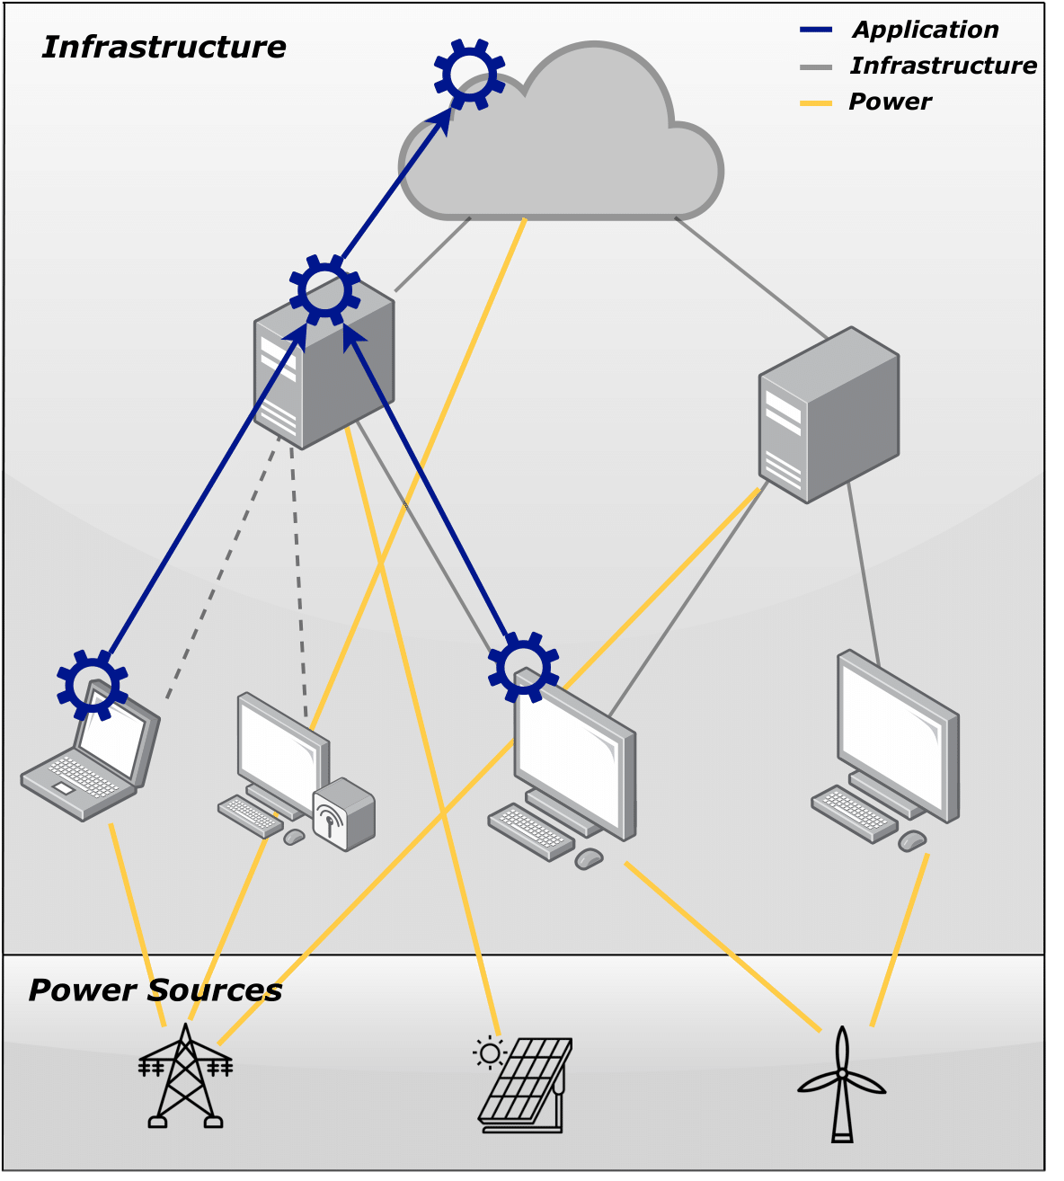
We Propose ECO-LEAF
An energy-aware fog computing simulator with power source modelling and carbon emission estimation capabilities, with the goals to:
(1) Introduce a means of modelling power sources.
(2) Provide carbon footprints for consuming power.
(3) Capturing and displaying results.
(4) Introduce example scenarios.
Introduces the ability to model various battery, grid and renewable power sources.
Aims to provide further research and industrial opportunities into exploring how providing energy to fog network infrastructure can impact the environment.
March 2024
Carbon Emission Estimation In Edge Cloud Computing Simulations
5
Notes:
We propose ECO-LEAF, an energy-aware fog computing simulator with power source modelling and carbon emission estimation capabilities. When the simulator was being developed, four principal goals were laid out for the product. First, the simulator should introduce a means of modelling power sources. The second goal was to ensure that the simulator could provide carbon footprints when devices consumed energy. The third being that ECO-LEAF could capture results and display them once the simulation had finished. Finally, the last goal was for ECO-LEAF to provide example scenarios of the simulation tool being used.
The key feature of ECO-LEAF is its ability to model various sources of power, including batteries, the grid, and renewable energy sources, which are modelled in a way that they could change during the simulation to reflect the model's current state.
ECO-LEAF provides these features to facilitate future research and industrial opportunities to explore how the environmental impact can change as a consequence of providing energy to network infrastructure at various times and locations.

Slide 6

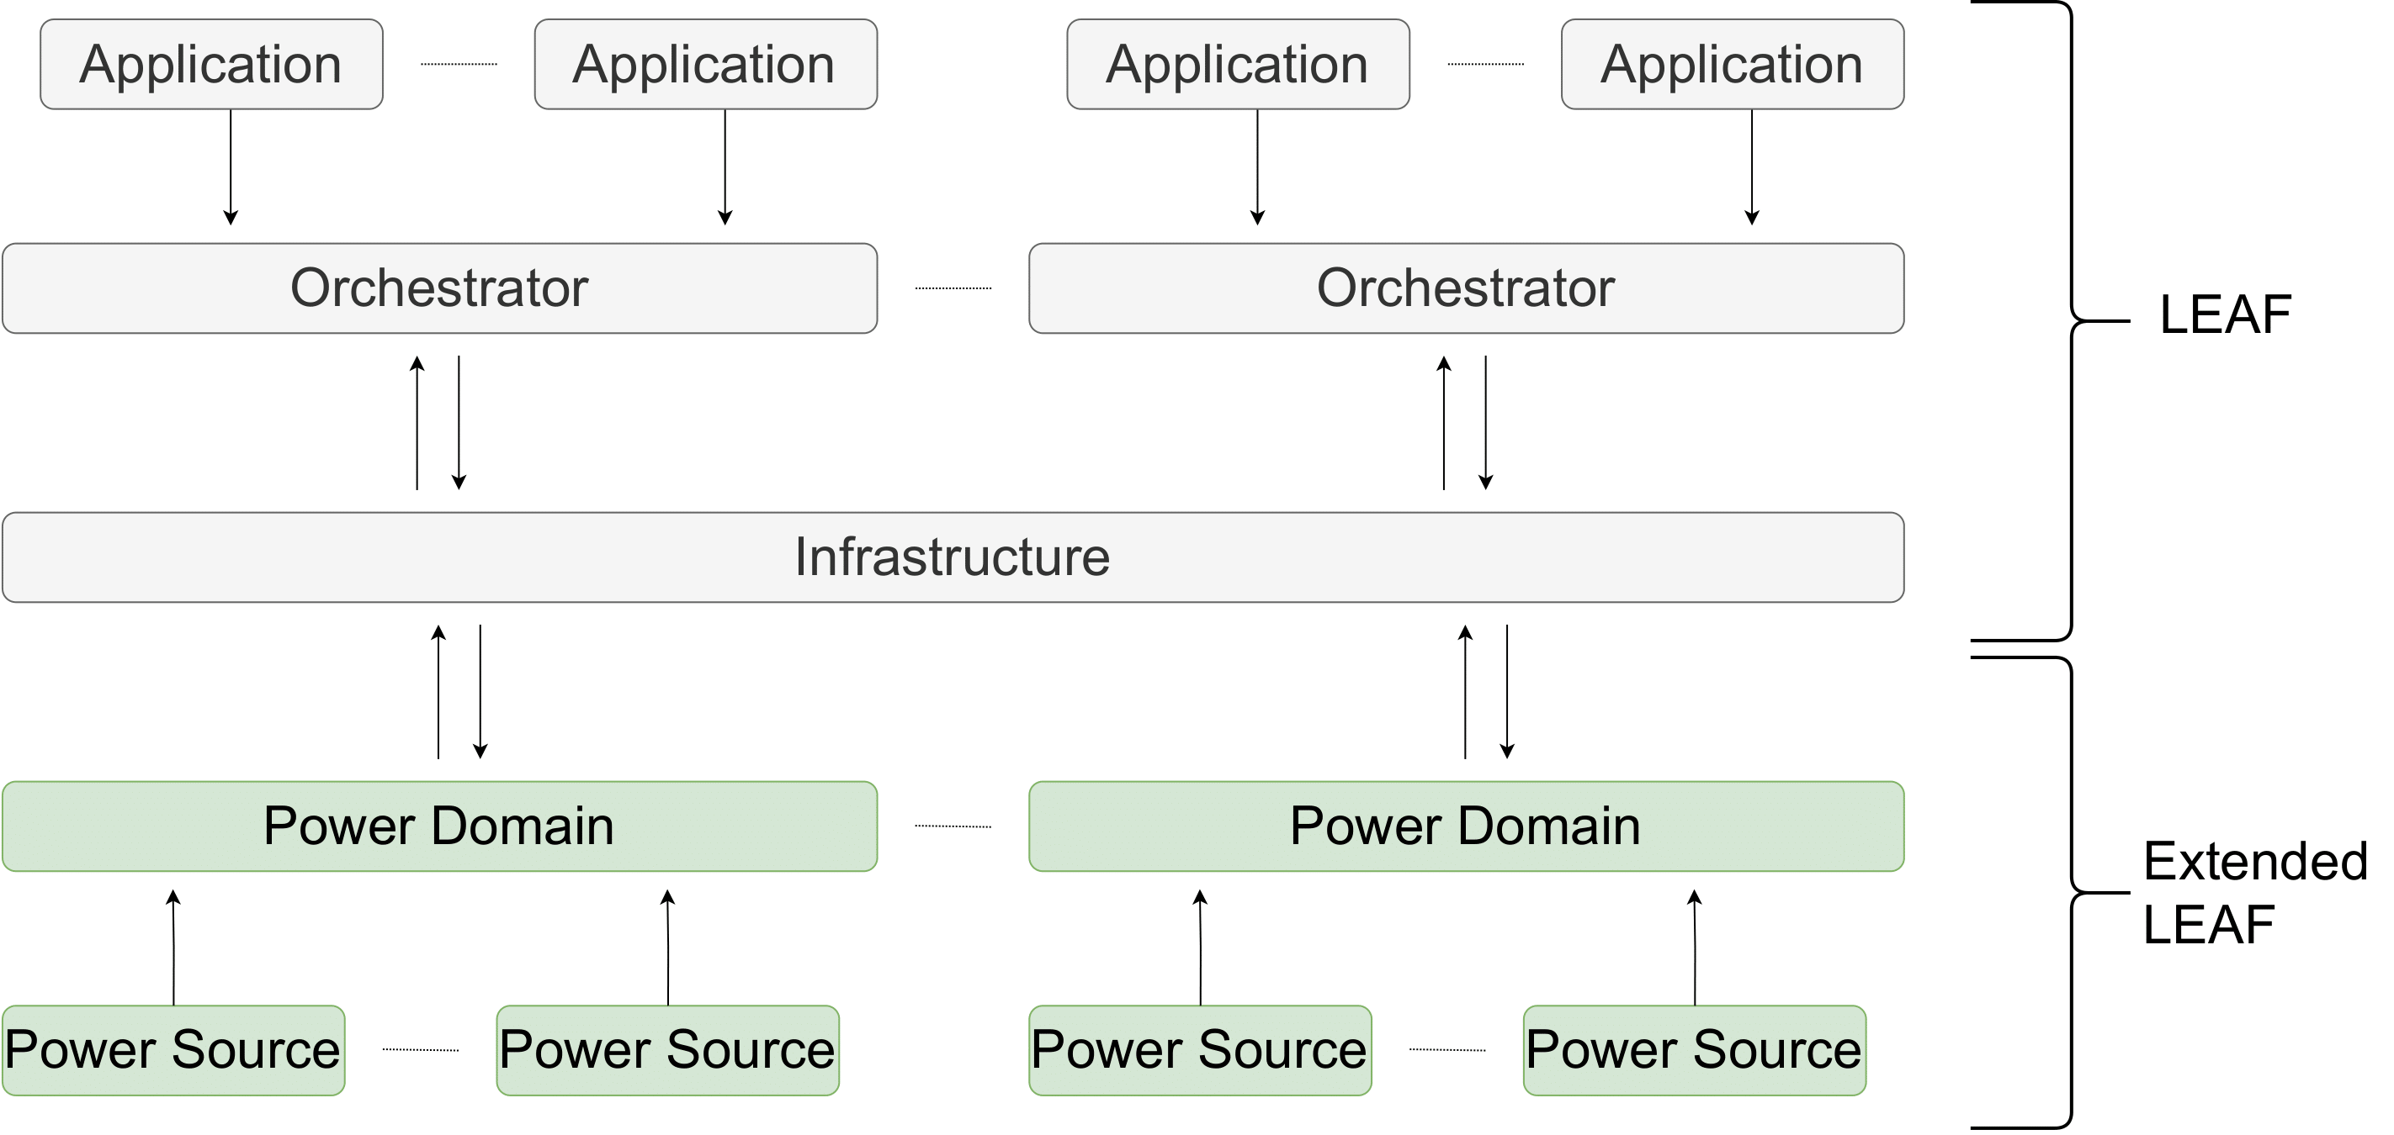
Power Sources and the Power Domain
Built using the LEAF framework.
LEAF (P. Wiesner and L. Thamsen)
Extend the architecture by introducing two core components:
Extend the architecture by introducing two core components:
The Power Domain
Extend the architecture by introducing two core components:
The Power Domain
The Power Source
Power Sources aim to model how power availability and carbon intensity change throughout the simulation.
Achieved using datasets.
Power Domains aim to act as the mediator by distributing energy between the Infrastructure and Power Source layers.
March 2024
Carbon Emission Estimation In Edge Cloud Computing Simulations
6
Notes:
ECO-LEAF was implemented using python and was built to extend upon the functionalities of the LEAF framework. Looking at the diagram we can see 3 core components in LEAF: The infrastructure which describes the topology of the fog network through compute nodes and communication links, Applications which describe the processes that run on the infrastructure, and finally the Orchestrator, a mediator used to determine how application tasks and data links are placed on the infrastructure.
ECO-LEAF sees to extend this architecture by introducing two new layers
Power domains
And power sources
Power sources aim to describe how their power availability and carbon intensity fluctuate throughout the course of the simulation. It achieves this by modelling these two values by utilising historical datasets that, for a given power source, demonstrate how these values change over a period of 24 hours. Power sources were implemented in a manner that allows users to define their own or to configure the power sources provided by ECO-LEAF.
Power domains were designed and implemented to address the problem of how power is provided from sources to Infrastructure. By acting as mediators, they are used to identify how the energy from power sources is allocated amongst links and nodes. As ECO-LEAF uses a discrete event simulator, the simulator can ensure that every device retains an association at all times by carrying out evaluations at every time step.

Slide 7
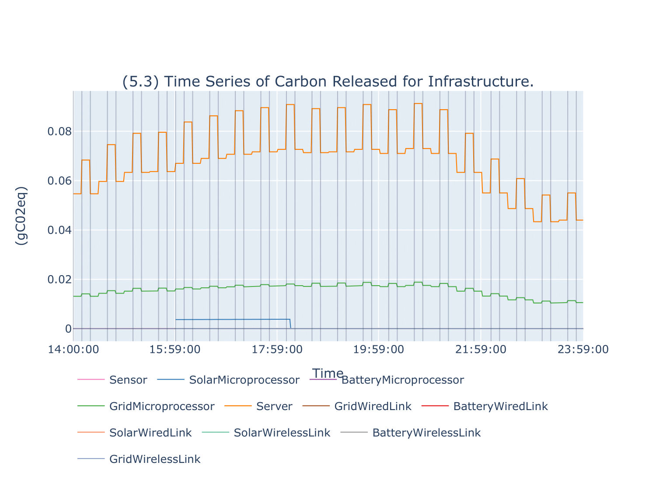
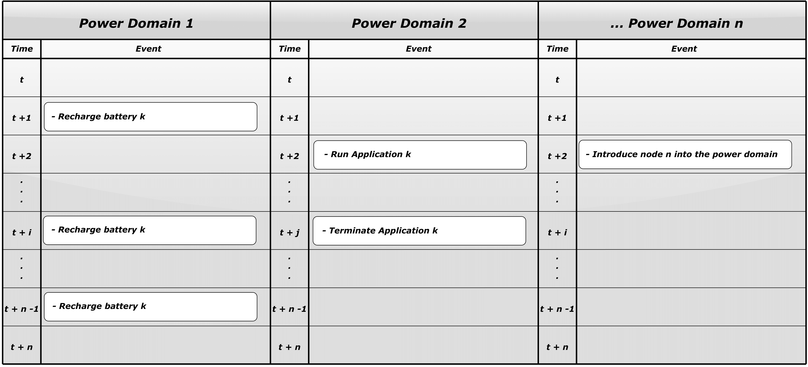
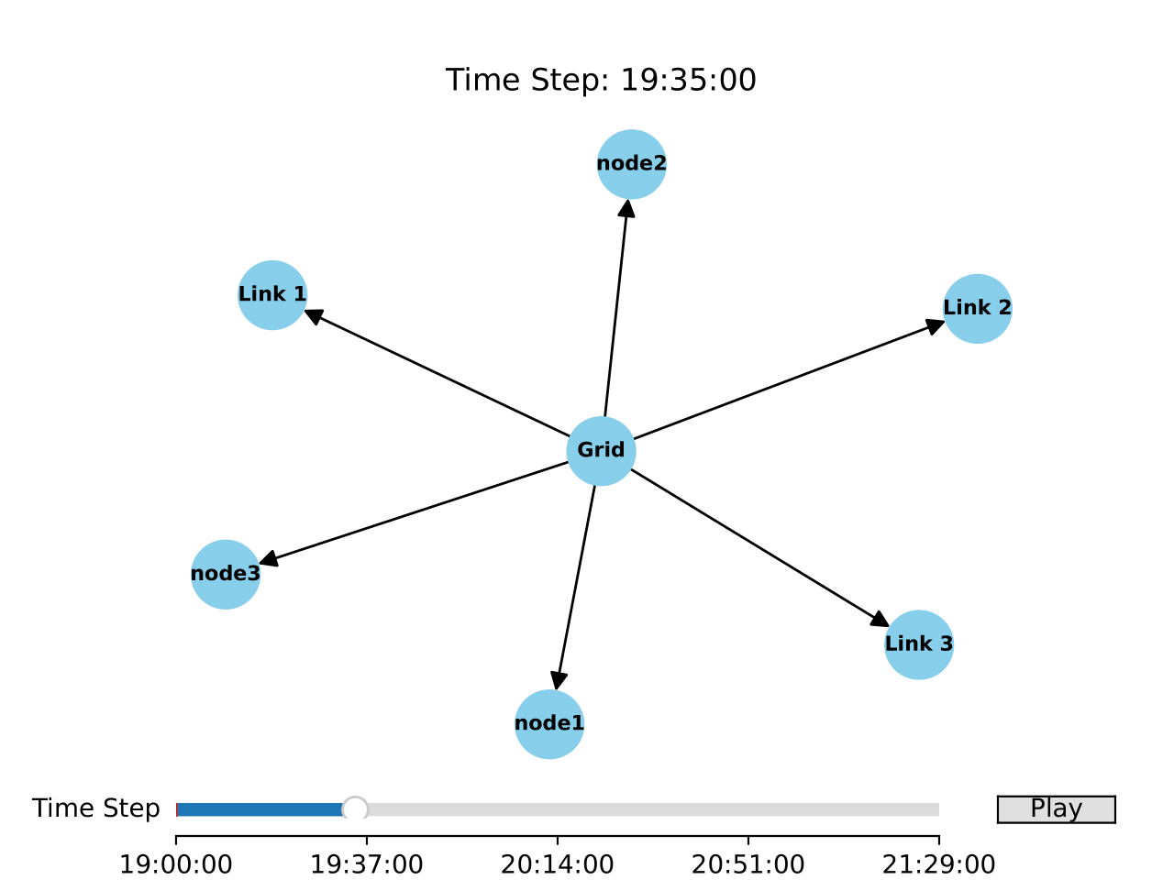
Events and Visualisation
March 2024
Carbon Emission Estimation In Edge Cloud Computing Simulations
7
Notes:
In order to improve the usability of LEAF, ECO-LEAF introduces an events mechanism. The aim of this feature is to remove the time spent writing logic to carry out changes in state outside of the default methods provided by ECO-LEAF. The events system achieves this by running independently within the simulation and has a list of user defined actions it needs to execute at specific moments in time. This can be seen in the figure which visualises this as a timetable for when actions should occur. Expanding on this further, events can also be considered as repeating, which indicate that particular events should always be executed after a set amount of time has passed.
The next key goal to address is the ability to capture and display results. During development, the goal was created after realising early on that no direct means of analysis was available for the results. As such ECO-LEAF utilises a directory-style data structure to store the simulation results; this approach allows for relations to be formed, reducing the need to write out relationships multiple times. As such the first tool created was the graphing tool. By choosing the measurement captured and the entities wanted to be plotted, ECO-LEAF automatically creates and formats line plots to show how state values change throughout the simulation.
However, this tool was not enough to carry out the needed analysis. An inherent issue with this approach is that despite showing how values like carbon released or energy consumed vary over time, these results do not show the relations between power sources and infrastructure. As such, the last tool created, the animator, aims to provide an interactive form of analysis to show how relationships change over time.

Slide 8
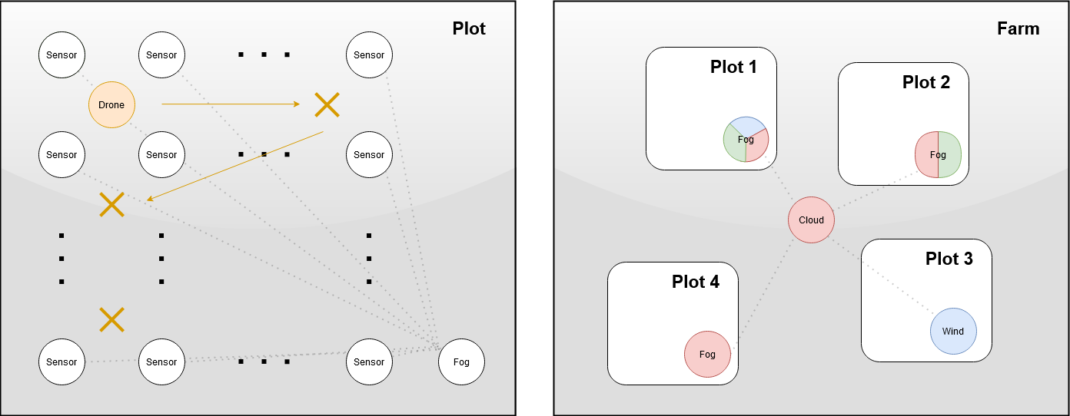
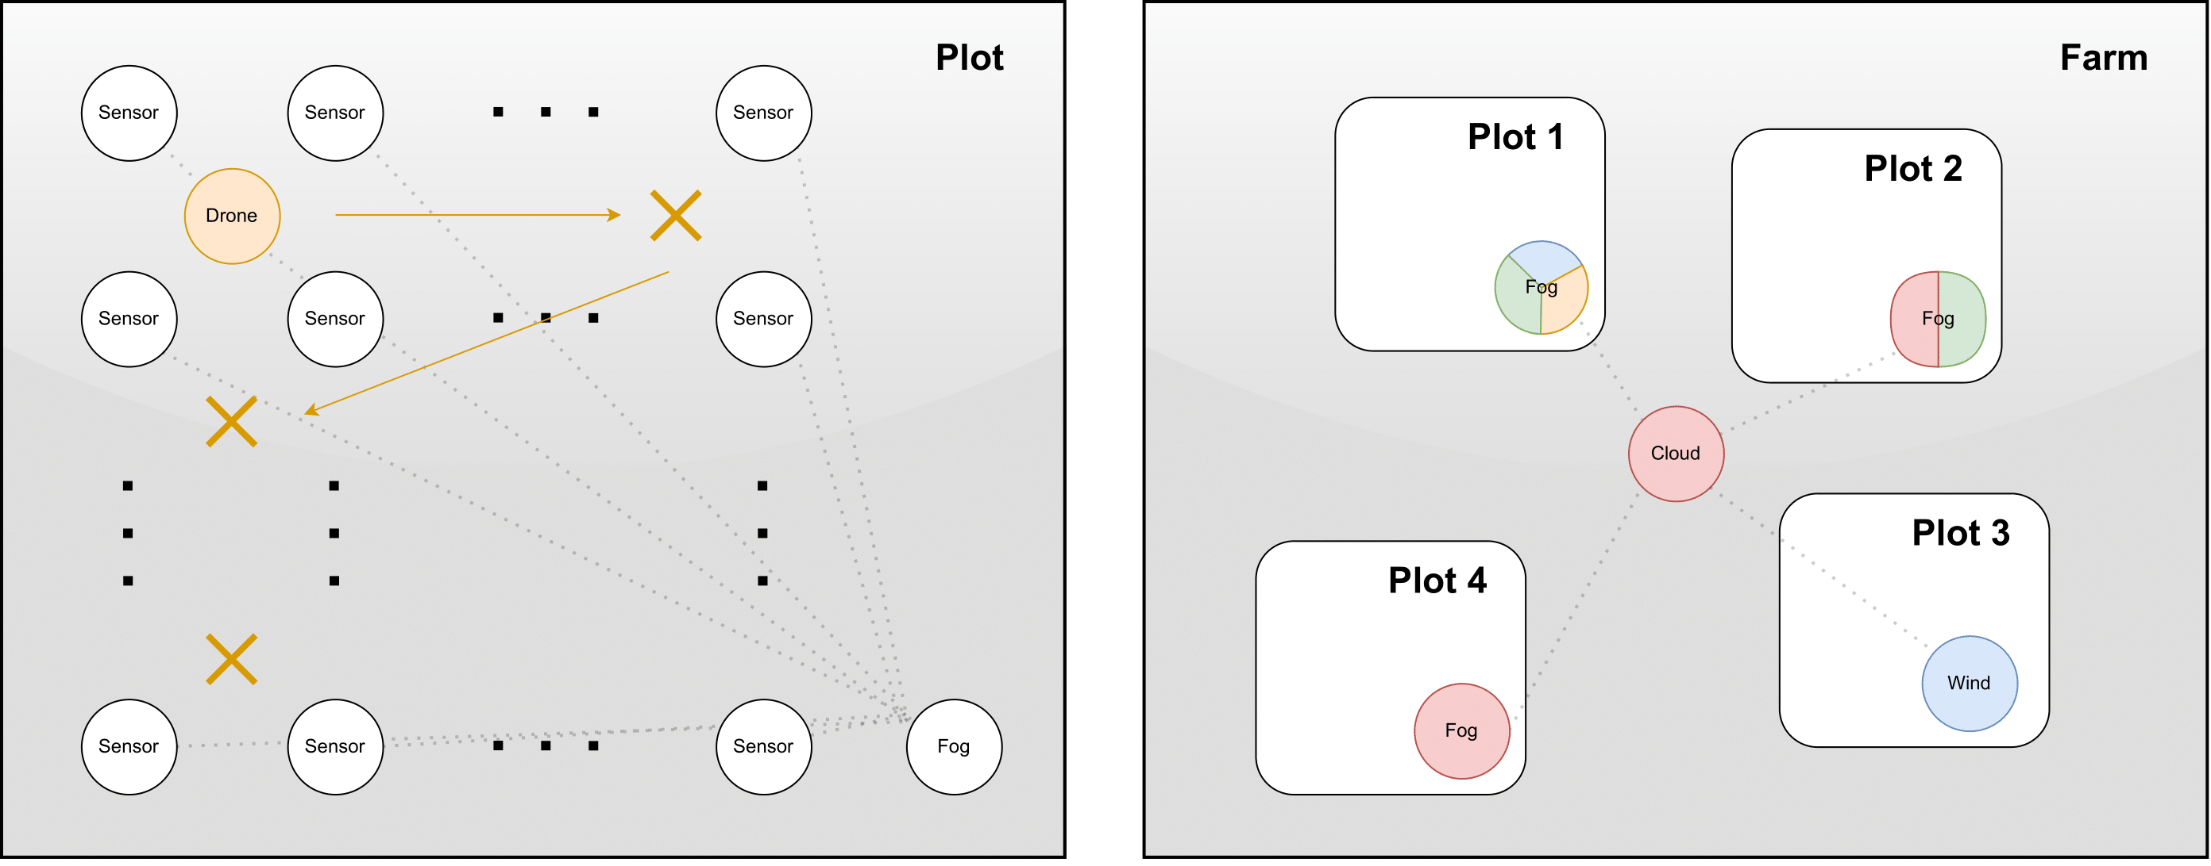
Evaluating ECO-LEAF: Scenario 7, Precision Agriculture
As a primary goal, 7 Scenarios were created during development in a precision farming setting to demonstrate ECO LEAF’s capabilities.
The evaluation's aim was to use several scenarios to show that the project's goals were achieved.
In this example we see the final scenario developed for precision agriculture
Four plots of farmland
Several available energy sources
Many sensors capturing data
Aim: demonstrate that carbon emissions varied because of available resources
March 2024
Carbon Emission Estimation In Edge Cloud Computing Simulations
8
Notes:
The final goal of ECO-LEAF was to consider multiple examples. As such, 7 scenarios were produced during development under a precision agriculture setting. Precision agriculture, was chosen as the context for the scenarios as they see to describe the capturing of information and processing at a central server, as such we used this to explore ways in which fog computing could be used to preprocess this data before reaching the server.
To evaluate ECO-LEAF several of these scenarios were used to identify when the project-specific goals were achieved.
In this scenario, we considered the final example, which represented ECO-LEAF's most realistic use case. In this context, we modelled a Northen Ireland farm with 4 plots of farmland. In these plots, an array of sensors in a grid pattern took readings of the soil contents. In addition, each plot employed a drone to take aerial readings of the local landscape. All of this data was sent to a single fog node on the plot to be pre-processed before being forwarded to the main server. The purpose of the scenario was to consider how carbon emissions varied due to available power sources for the farm.
As we can see in this figure Plot 1 was provided wind solar grid and battery power, plot 2 was provided solar grid and battery power, plot 3 was provided wind and battery and finally plot 4 was provided grid and battery

Slide 9
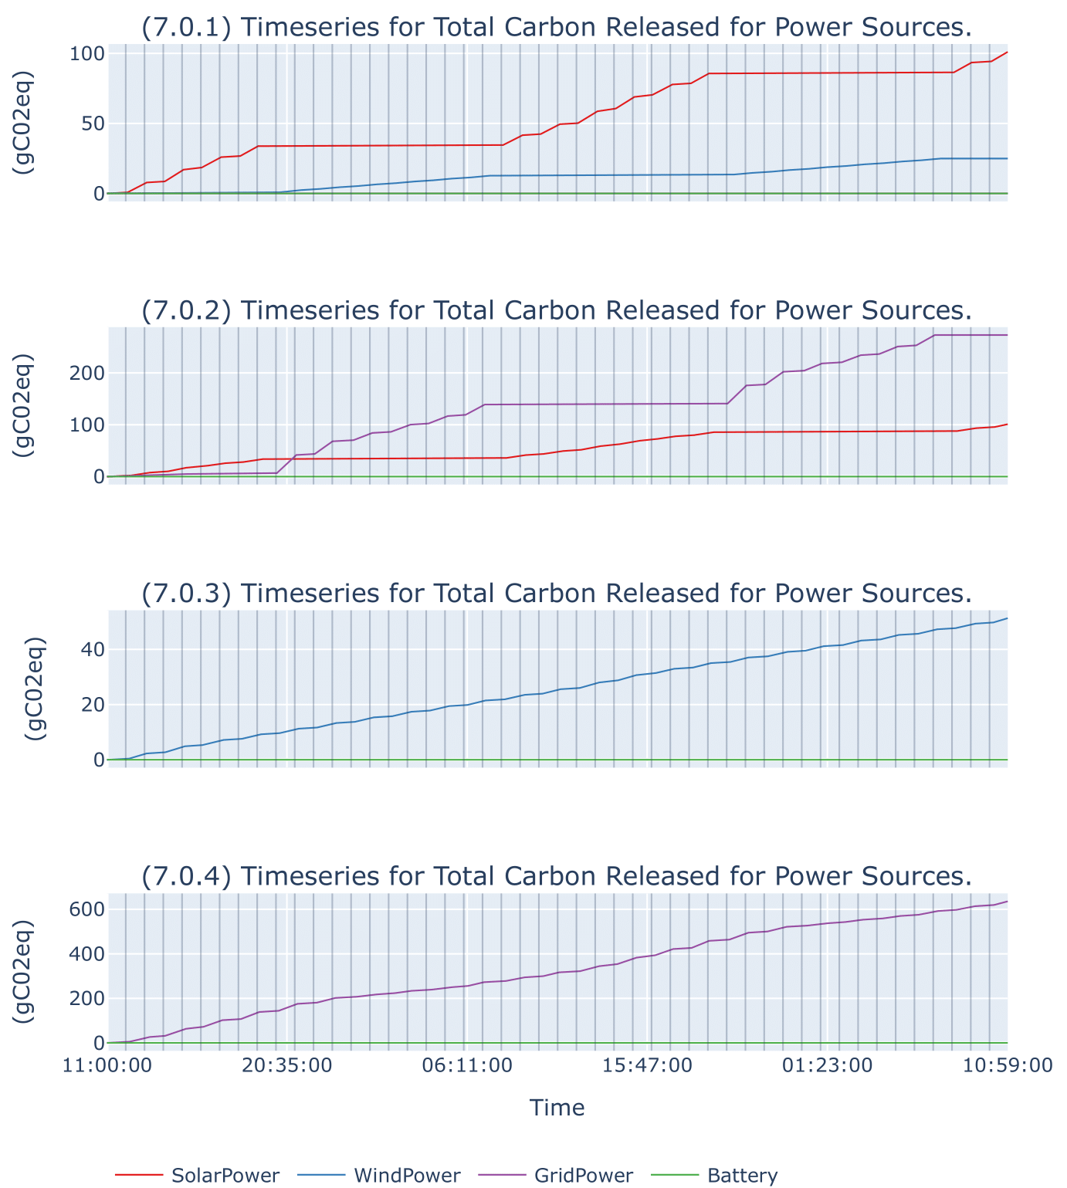
Results
Carbon emissions estimations varied for different plots:
Carbon emissions estimations varied for different plots:
Plot 1 (W, S, G, B) produced 127 gCo2eq.
Carbon emissions estimations varied for different plots:
Plot 1 (W, S, G, B) produced 127 gCo2eq.
Plot 2 (S, G, B) produced 379 gCo2eq.
Plot 3 (W, B) produced 52 gCo2eq.
Carbon emissions estimations varied for different plots:
Plot 1 (W, S, G, B) produced 127 gCo2eq.
Plot 2 (S, G, B) produced 379 gCo2eq.
Plot 3 (W, B) produced 52 gCo2eq.
Plot 4 (G, B) produced 641 gCo2eq.
Carbon emissions estimations varied for different plots:
Plot 1 (W, S, G, B) produced 127 gCo2eq.
Plot 2 (S, G, B) produced 379 gCo2eq.
Plot 3 (W, B) produced 52 gCo2eq.
Plot 4 (G, B) produced 641 gCo2eq.
Differences in emissions between the highest and lowest plots was 90%.
Carbon emissions estimations varied for different plots:
Plot 1 (W, S, G, B) produced 127 gCo2eq.
Plot 2 (S, G, B) produced 379 gCo2eq.
Plot 3 (W, B) produced 52 gCo2eq.
Plot 4 (G, B) produced 641 gCo2eq.
Differences in emissions between the highest and lowest plots was 90%.
As a result, it was clear that ECO-LEAF achieved its goal for the scenario by producing different carbon emissions due to the different sources that were available.
Carbon emissions estimations varied for different plots:
Plot 1 (W, S, G, B) produced 127 gCo2eq.
Plot 2 (S, G, B) produced 379 gCo2eq.
March 2024
Carbon Emission Estimation In Edge Cloud Computing Simulations
9
Notes:
Looking at the results of the simulation we can see that it is clear that the ECO-LEAF achieved this goal. In the first plot we considered all available power sources and as a consequence 127 grams of carbon dioxide emissions were produced.
For plot 2 wind power was not considered and the emissions increased to 379 grams of carbon dioxide , this was because as we can see during the night rather than being able to utalise wind power, grid was used instead.
In plot 3 we can see that the lowest emissions were generated at only 52 grams of carbon dioxide. As wind has the smallest inherent carbon intensity the smallest amount of emissions were produced.
Finally when only grid was used we can see the opposite effect, where 641 grams of carbon dioxide were released. As the grid produces carbon explicitly in the generation process, we can see this reflect the final results.
Carrying out some quick analysis on these values we can see that the percentage difference between the highest and lowest emissions was 90%, just by swapping from grid to wind power.
Because of these results its clear to say that ECO-LEAF achieved the goal set out for this scenario as we can clearly that providing different power sources resulted in different carbon emissions.

Slide 10
Future Work
Introduce new model options for power availability and carbon intensity:
Numerical equations that could potentially introduce randomness to model variability between days.
Artificial intelligence models that utilise historical data to consider other factors such as long-term patterns like seasons and weather patterns throughout the year.
Rework power sources to accommodate batteries better:
Seek to re-design how power sources are constructed and consider them as two components, a power generator and an optional energy store.
Allowing batteries to be represented as an energy store without an explicitly defined generator.
Finally, introduce the ability to adjust the granularity of time.
Allow for a user-definable step forward in time to allow for the user to determine the precision needed at the expense of performance
March 2024
Carbon Emission Estimation In Edge Cloud Computing Simulations
10
Notes:
While in the end eco leaf achieved all its goals set out at the beginning of the project, future work can still be carried out
First would be to Introduce new model options for power availability and carbon intensity:
Numerical equations that could potentially introduce randomness to model variability between days.
Artificial intelligence models that utilise historical data to consider other factors such as long-term patterns like seasons and weather patterns throughout the year.
Rework power sources to accommodate batteries better:
Seek to re-design how power sources are constructed and consider them as two components, a power generator and an optional energy store.
Allowing batteries to be represented as an energy store without an explicitly defined generator.
Finally, introduce the ability to adjust the granularity of time
Allow for a user-definable step forward in time to allow for the user to determine the precision needed at the expense of performance

Slide 11
Summary
Following the rapid adoption of the IoT, fog computing was proposed to reduce processing at centralised data centres.
Many energy-aware fog computing simulations exist; however, most fail to consider how power is generated and consider the carbon emissions as a result of consuming this power.
We propose ECO-LEAF, an energy-aware fog computing simulator that models power sources and estimates carbon emissions.
ECO-LEAF allows for models of power availability and carbon intensity through historical data sets.
To evaluate ECO-LEAF, several scenarios were created to demonstrate its capabilities and identify when the product’s goals had been met.
For instance, the last scenario demonstrates how carbon emissions can vary because of varying available power sources.
Finally, possible future work can be done to ECO-LEAF to improve upon the simulation tool to further improve the accuracy of results and improve the user experience in creating scenarios.
March 2024
Carbon Emission Estimation In Edge Cloud Computing Simulations
11

Slide 12
Thank You
March 2024
Carbon Emission Estimation In Edge Cloud Computing Simulations
12
Notes:
Thank you for listening to my dissertation presentation, if you have any questions about the project please feel free to get in con

Slide 13
References
C. Freitag, M. Berners-Lee, K. Widdicks, B. Knowles, G. S. Blair, and A. Friday. The real climate and transformative impact of ict: A critique of estimates, trends, and regulations. Patterns, 2(9):100340, 2021b. ISSN 2666-3899. doi: https://doi.org/10.1016/j.patter. 2021.100340. URL https://www.sciencedirect.com/science/article/pii/ S2666389921001884.
National Grid ESO. Carbon intensity api. https://carbonintensity.org.uk/. Accessed: 11/10/2023.
Savills Research. Spotlight: European data centre, deep dive in the data sphere, 2022. URL https://www.savills.com/research_articles/255800/335857-0. Accessed: 25/03/2024.
P. Wiesner and L. Thamsen. Leaf: Simulating large energy-aware fog computing environments. In 2021 IEEE 5th International Conference on Fog and Edge Computing (ICFEC), pages 29–36. IEEE, 2021.
M. Yan, C. A. Chan, A. F. Gygax, J. Yan, L. Campbell, A. Nirmalathas, and C. Leckie. Modeling the total energy consumption of mobile network services and applications. Energies, 121), 2019. ISSN 1996-1073. doi: 10.3390/en12010184. URL https://www.mdpi.com/1996-1073/12/1/184.
March 2024
Carbon Emission Estimation In Edge Cloud Computing Simulations
13

